Slide 1
Encoding and Decoding Of a Message
Python Hackathon Project
B-203 TEAM 10

Slide 2
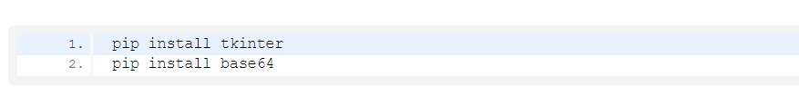
Project Prerequisites
To build this project we will use basic concept of python, Tkinter, and base64 library.
Tkinter is a standard GUI python library
base64 module provides a function to encode the binary data to ASCII characters and decode that ASCII characters back to binary data.
To install the library we use pip install command on the command prompt

Slide 3
Project File Structure
These are the step to build message encode – decode python project
Import module
Create display window
Define function
Define labels and buttons
So this is what we will do in this python project. Let’s start

Slide 4
Steps to develop message encode-decode project
Import Libraries
The first step is to import tkinter and base64 libraries.

Slide 5
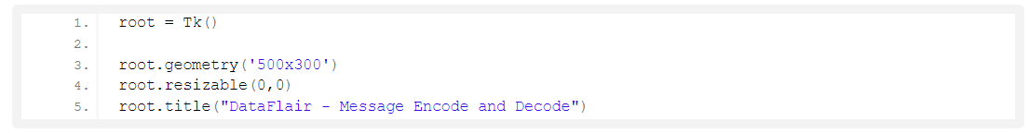
2. Initialize Window
Tk() initialized tkinter which means window created
geometry() set the width and height of the window
resizable(0,0) set the fixed size of the window
title() set the title of the window
Label() widget use to display one or more than one line of text that users aren’t able to modify.
root is the name which we refer to our window
text which we display on the label
font in which the text is written
pack organized widget in block

Slide 6
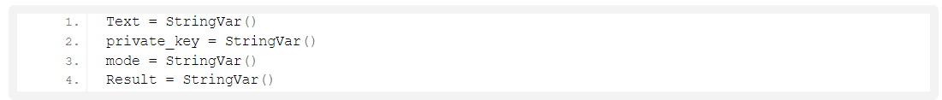
3. Define variables
Text variable stores the message to encode and decode
private_key variable store the private key used to encode and decode
mode is used to select that is either encoding or decoding
Result store the result

Slide 7
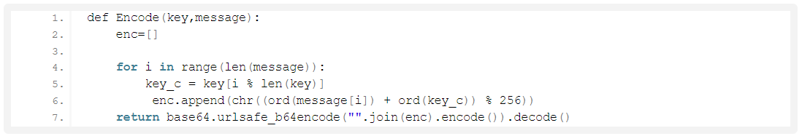
4. Function to encode
enc = [] is an empty list
We run loop till the length of the message
i% of len(key) gives the remainder of division between i and len(key) and that remainder used as an index of key the value of key at that index is stored in key_c
ord() function takes string argument of a single unicode character and return its integer unicode value
chr() function takes an integer argument and returns the string.
ord (message[i]) convert the value of message at index i into the integer value
ord(key_c) converts the key_c value to integer value
ord(message[i]) + ord(key_c)) % 256 gives the remainder of division of addition of ord(message[i]) and ord( key_c) with 256 and passes that remainder to chr() function
chr() function converts that integer value to string and store to enc
base64.urlsafe_b64encode encode a string.
The join() method joins each element of list, string, and tuple by a string separator and returns the concatenated string.
encode() method returns utf-8 encoded message of the string.
decode() method decodes the string.
return gives the result of the encoded string.

Slide 8
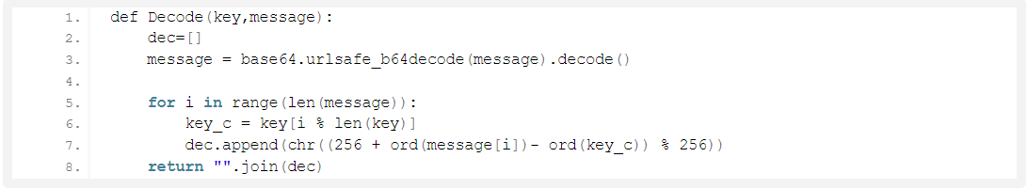
5. Function to decode
Decode() function has arguments – key, message
dec=[] is an empty list
Decode the content from input and write the result in binary to the output
We ran the loop till the length of the message
256 + ord(message[i]) – ord(key_c)) % 256 gives the remainder of addition of 256 with subtraction of ord(message[i]) – ord( key_c) and then division with 256 and passes that remainder to chr() function
chr() function convert integer value to string and store to dec
return “”.join(dec) return the result

Slide 9
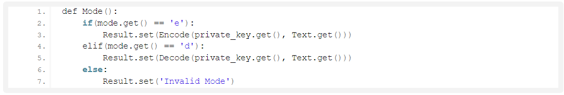
6. Function to set mode
If the mode set by the user is ‘e’ then the Encode() function will be called
If the mode set to ‘d‘ then the Decode() function will be called
Else print ‘invalid mode’
private_key.get() and Text.get() values are pass to the arguments of Encode() and Decode() function

Slide 10
7. Function to exit window
root.destroy() will quit the program by stopping the mainloop()

Slide 11
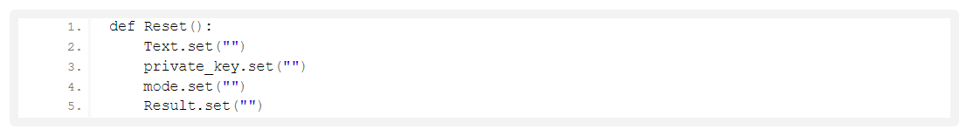
8. Function to reset window
This function set all variables to empty string

Slide 12
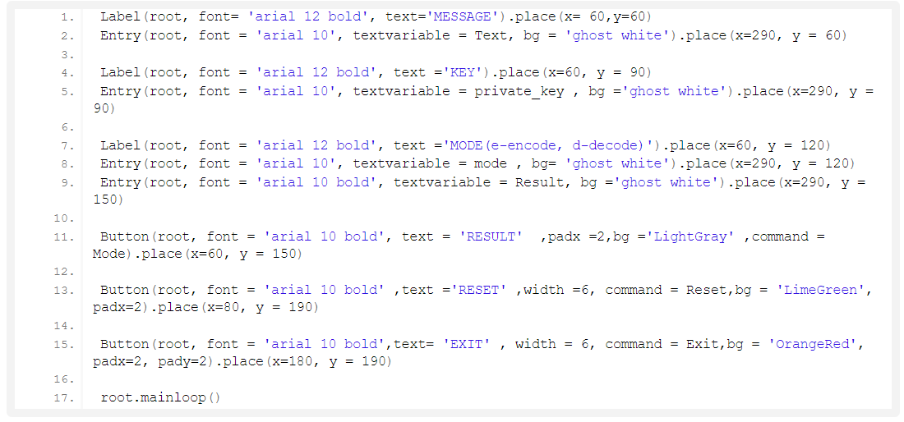
9. Labels and Buttons
root is the name which we refer to our window
text which we display on the label
font in which the text is written
insertwidth use to set the width of the insertion cursor
bg sets the background colour
command is call when the button is click
textvariable used to retrieve the current text to the entry widget
root.mainloop() is a method that executes when we want to run our program.
Label() widget use to display one or more than one line of text that users aren’t able to modify.
Entry() widget used to create an input text field.
Button() widget used to display button on our window

Slide 13
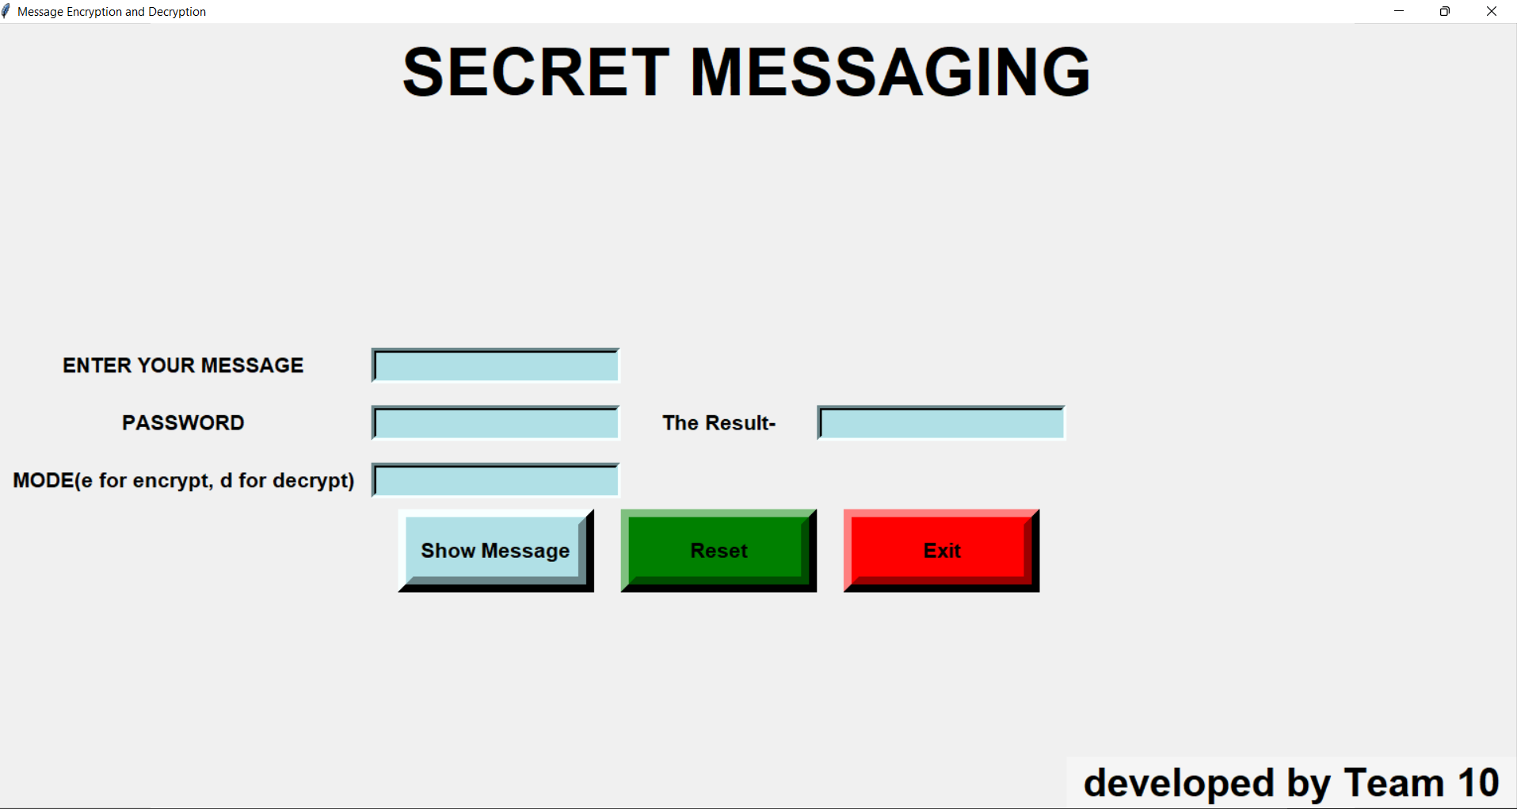
Message Encode-Decode Project output

Slide 14
THE END

